Slide 1
Programmable Logic Controllers for Industrial Applications Nicolae-Andrei Vasile
Thesis advisor:
Conf. Dr. Ing. Dan Stefan Tudose

Slide 2

Industrial Automation
represents the use of control systems, such as robots and specialized computers to replace human operation
focus of research attention in both academia and industry alike for several decades
can perform consistently for large batch production or flexibly for small batch jobs
able to bridge the gap between product design and process planning

Slide 3
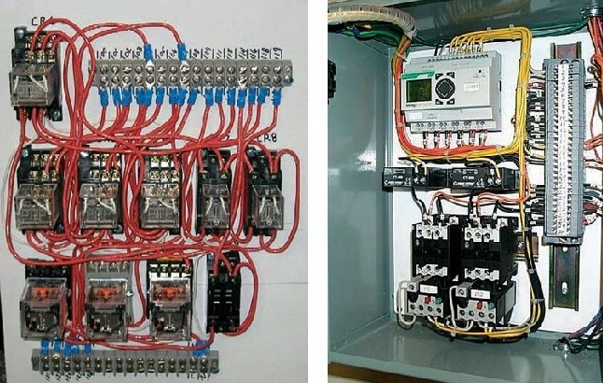
History
delays were used to control the automation processes in industrial environment before 1970’s
debugging relay failures and changing became extremely time-consuming and costly
in 1968, , Hydramatic Division of General Motors Corporation (GM) specified the design criteria for the first PLC
Relay Logic vs. PLC

Slide 4
Programmable Logic Controller (PLC)
is an electronic device used in many industries to monitor and control building systems and production processes
designed to perform a single set of tasks under real-time constraints and with superior reliability and performance
can be placed in an industrial environment with harsh characteristics
the software for the PLCs can be developed using a variety of programming languages

Slide 5
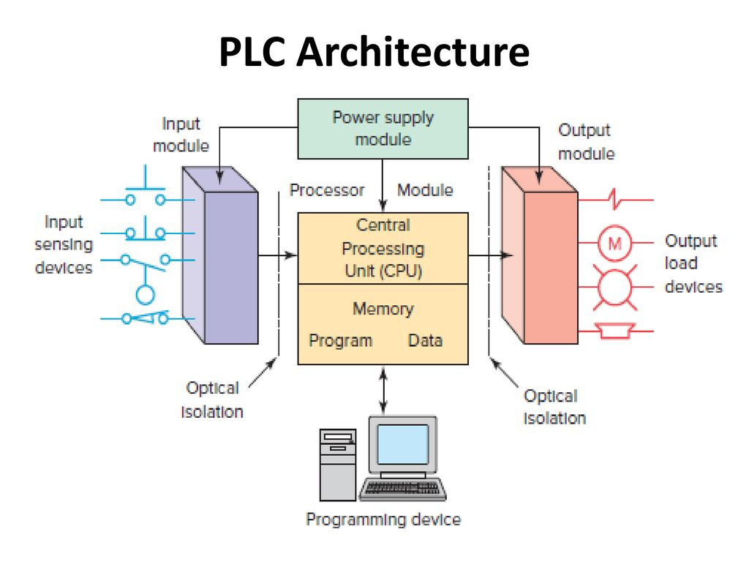
Hardware Architecture
a typical hardware architecture of a PLC consist of:
Central Processing Unit (CPU)
Input and Output (I/O) modules
Power supply
in a small PLC, all the described parts are enclosed in a single compact unit, in contrast to larger PLCs, that have the possibility of acquiring them separately

Slide 6
Standards and Norms
very influential in the design and development of industrial automation software
provide the technical rules that ensure the safety and performance
most important standards:
IEC 61131-3 (IEC standard for programmable controllers)
IEC 61499 (distributed automation intelligence in systems with decentralized logic)
notable mentions:
ISA 88/95 (application configuration and system integration problems)
IEC 61804 (specification and requirements of distributed process control systems based on function blocks)
IEC 61850 (standardizes communication to avoid the use of vendor-specific protocols in power systems automation)

Slide 7
Programming Languages
standardized in IEC 61131-3 (IEC standard for programmable controllers)
two textual languages:
Structured Text (ST)
Instruction List (IL)
two diagrammatic languages:
Function Block Diagrams (FBD)
Ladder Logic Diagrams (LLD or RLL)

Slide 8
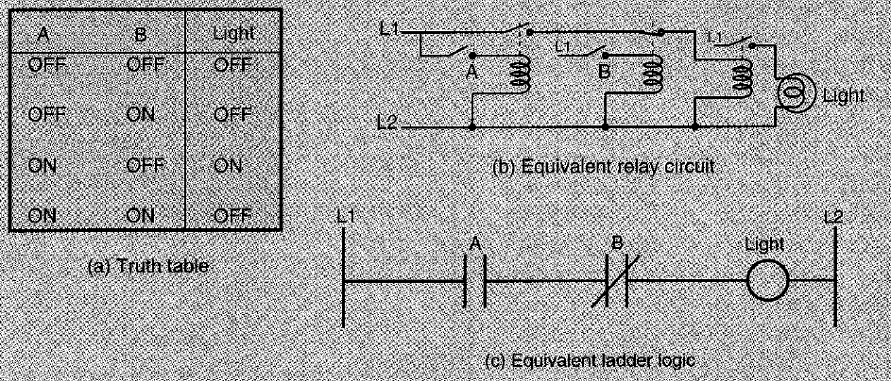
Relay Ladder Logic (RLL)
only a symbolistic representation of the computer program
fundamental symbols:
normally open (NO) contacts
normally closed (NC) contacts
output (relay coils)
rungs
power rails
logic flows from the left power rail to the right power rail, and from the top rung to the bottom one

Slide 9
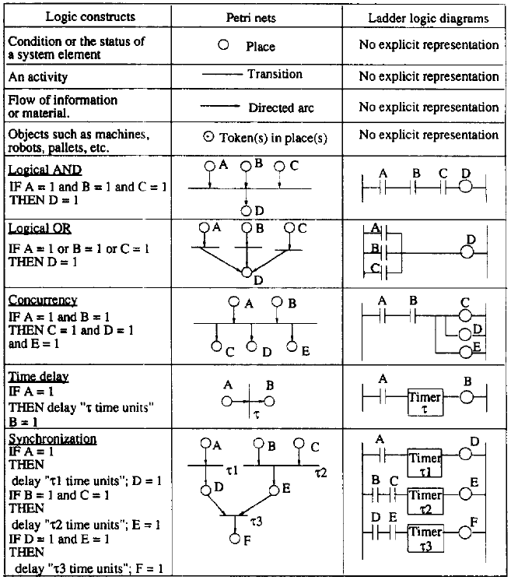
Petri Nets
RLL was developed to smooth the transition from relay control systems to PLC’s
LLDs grew more and more in complexity making the troubleshooting process extremely difficult, as the control system became larger
a graph-related model and a visually graphical tool designed for modeling, analysis, performance evaluation, and control of discrete event systems
display great flexibility and understandability of the process, exceeding today’s standard RLL programming techniques

Slide 10
Software Engineering in Industrial Automation
has become more and more relevant in the industrial automation domain
important software requirements in developing industrial applications:
interoperability
heterogeneity
scalability
dependability
distribution
software design models:
formal models (dependable software for industrial systems)
multi-agent architectures (modularity, scalability and flexible software design)
service-oriented architectures (interoperability, distribution, contributing to scalability and flexibility as well)

Slide 11
Conclusion
basic overview of the industrial automation domain and programmable logic controllers (PLCs)
a large and growing area with a rich body of knowledge
documenting various approaches for the issues that today’s industry and academic institutions are facing
build a programmable logic controller on our own, using the techniques that fit our requirements and purposes most

Slide 12
Bibliography
K. T. Erickson, "Programmable Logic Controllers," IEEE Potentials, vol. 15, no. 1, pp. 14-17, 1996.
G. Frey and L. Litz, "Formal methods in PLC programming," in IEEE International Conference on Systems, Man and Cybernetics, Nashville, TN, USA, 2000.
V. Vyatkin, "Software Engineering in Industrial Automation: State-of-the-Art Review," IEEE Transactions on Industrial Informatics, vol. 9, no. 3, pp. 1234-1249, 2013.
D. Schütz, A. Wannagat, C. Legat and B. Vogel-Heuser, "Development of PLC-Based Software for Increasing the Dependability of Production Automation Systems," IEEE Transactions on Industrial Informatics, vol. 9, no. 4, pp. 2397-2404, 2013.
O. G. Bellmunt, D. Montesinos-Miracle, A. Sumper, S. Galceran-Arellano and A. Sudrià-Andreu, "A Distance PLC Programming Course Employing a Remote Laboratory Based on a Flexible Manufacturing Cell," IEEE Transactions on Education, vol. 49, no. 2, pp. 278-284, 2006.

Slide 13
M. G. Ioannides, "Design and Implementation of PLC-Based Monitoring Control System for Induction Motor," IEEE Transactions on Energy Conversion, vol. 19, no. 3, pp. 469-476, 2004.
V. Vyatkin, "IEC 61499 as Enabler of Distributed and Intelligent Automation: State-of-the-Art Review," IEEE Transactions on Industrial Informatics, vol. 7, no. 4, pp. 768-781, 2011.
M. Zhou and E. Twiss, "Design of Industrial Automated Systems Via Relay Ladder Logic Programming and Petri Nets," IEEE Transactions on Systems, Man and Cybernetics - part C: Applications and Reviews, vol. 28, no. 1, pp. 137-149, 1998.
K. Venkatesh, M. Zhou and R. J. Caudill, "Comparing Ladder Logic Diagrams and Petri Nets for Sequence Controller Design Through a Discrete Manufacturing System," IEEE Transactions on Industrial Electronics, vol. 41, no. 6, pp. 611-619, 1995.
T. Cucinotta, A. Mancina, G. Anastasi, G. Lipari, L. Mangeruca, R. Checcozzo and F. Rusinà, "A Real-Time Service-Oriented Architecture for Industrial Automation," IEEE Transactions on Industrial Informatics, vol. 5, no. 3, pp. 267-276, 2009.

